Slide 1
Unbreakable Azure Devops Pipeline using Dynatrace
Safia Habib

Slide 2
Pre Requisites
Download the Source code from here.
Create Azure Devops account from here
Create Azure Portal account from here
Create a Notepad (Name – Azure_Devops_values) with the following:
URL to Monspec File:
URL to PipelineInfo File
PAT:
Dynatrace_Tenant:
Dynatrace_Tenant_Token:
Dynatrace_API_TOKEN:
SelfHealing Function URL:
UnbreakablePipelienGate Function URL:
Unbreakable pipeline Function Token:

Slide 3
THE BIG PICTURE What we are going to do today!

Slide 4


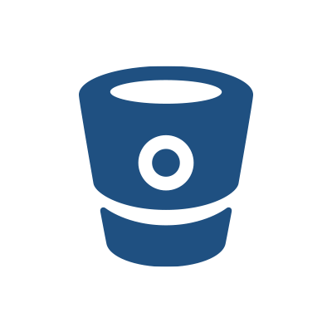









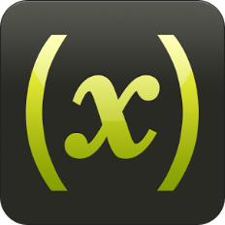




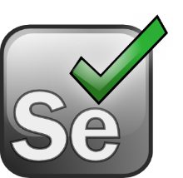










Shift-Left: Break Pipeline Earlier
Shift-Right: Tags, Deploys, Events
Dev
Perf/Test
Ops
Biz
Actionable Feedback Loops
Path to NoOps: Self-Healing, …
Notes:
But there is more than production! There is more we can do throughout the whole DevOps Toolchain

Slide 5
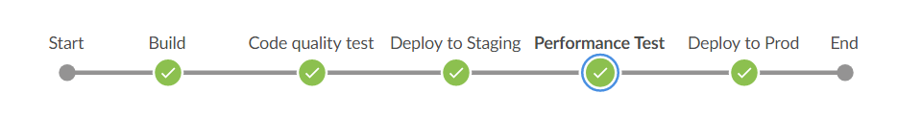
Microsoft Azure
Dynatrace Tenant
Monitoring Data
Azure Devops
Pipeline View

Slide 6
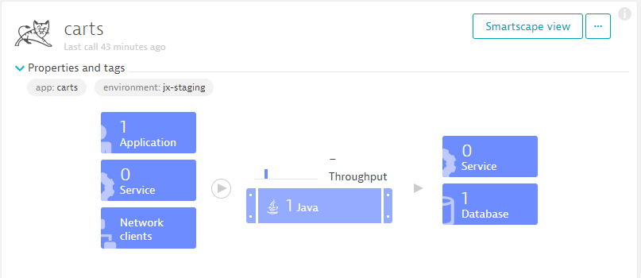

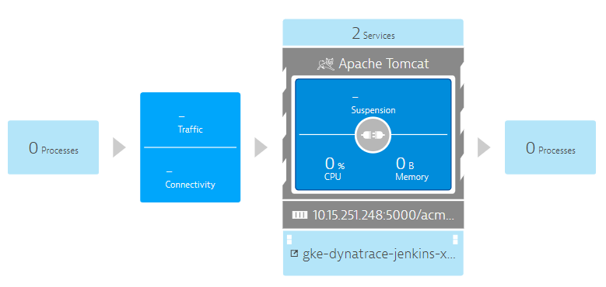
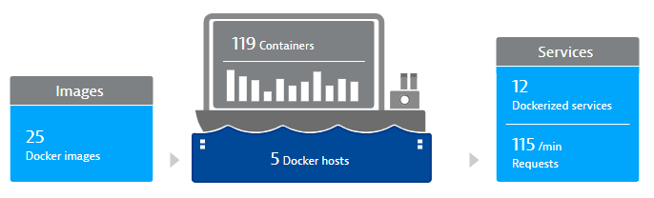
Microsoft Azure
Dynatrace Tenant
Monitoring Data
(1) Full Stack Monitoring Data in Dynatrace
(1) Automatic Monitoring
(1) Deploy OneAgent
Azure Devops
Pipeline View

Slide 7

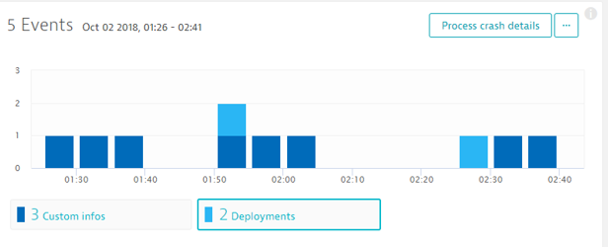
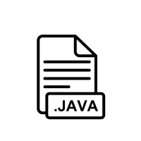

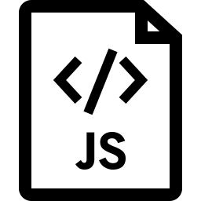
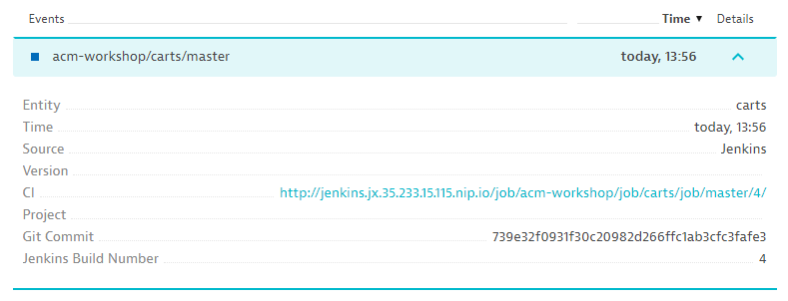
Microsoft Azure
Dynatrace Tenant
Monitoring Data
(2) Service Monitoring & Event Insights
(2) push deploy events
(2) Build & deploy to environment
Azure Devops
Pipeline View
(2)
(2)

Slide 8
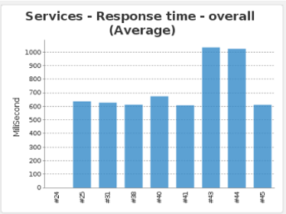
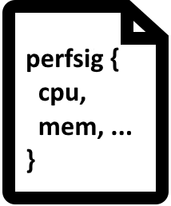
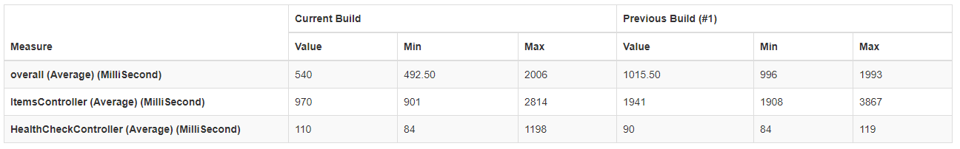
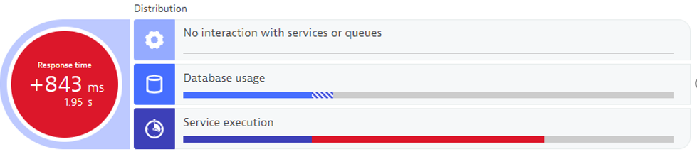
Microsoft Azure
Dynatrace Tenant
Monitoring Data
(4) Quality Gate Metrics Build over Build
(4) Pull Performance Signature Metrics & Push Validation Event
Azure Devops
Automatic Comparison between Builds
Pipeline View
(4)

Slide 9
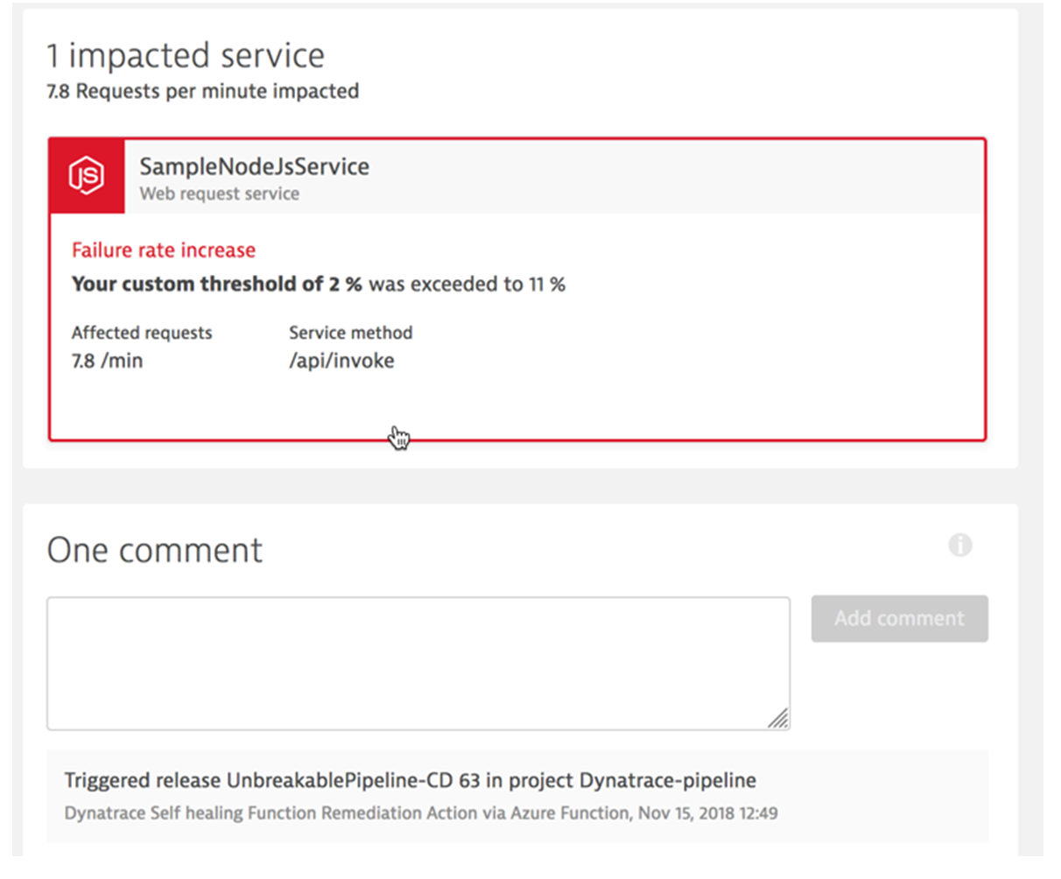
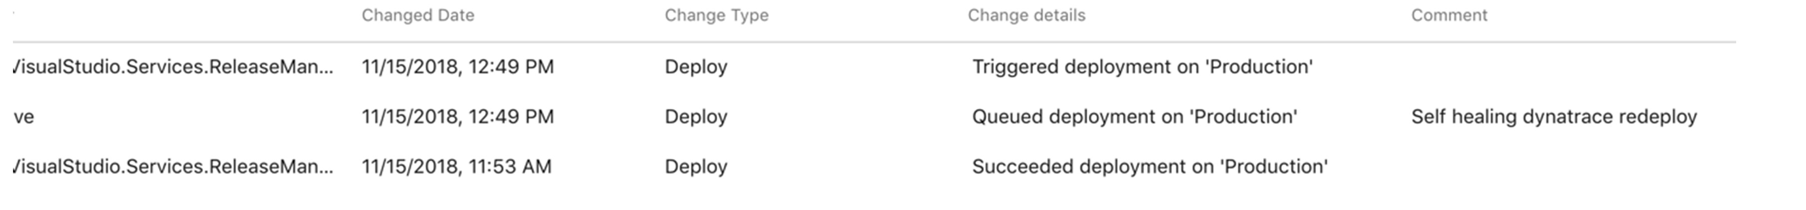
Microsoft Azure
Dynatrace Tenant
Monitoring Data
(5) Self Healing Revert back build
(5)- Problem Event
(5)- Deploy Previous good Build
Redeploy good Build into Prod
Azure Devops
Pipeline View
Self Healing

Slide 10
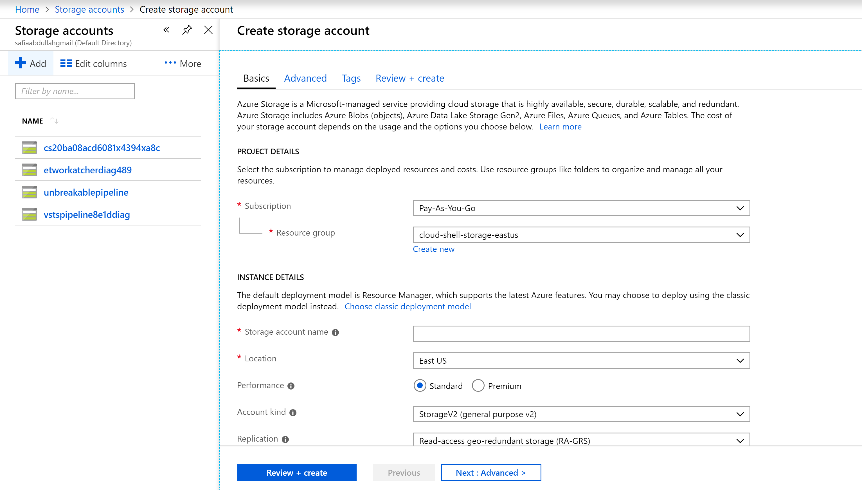
Step 1 : Storage Account
Login to Azure Portal
Create Storage Account
Upload the Monspec folder from the source code to a new Blob container

Slide 11
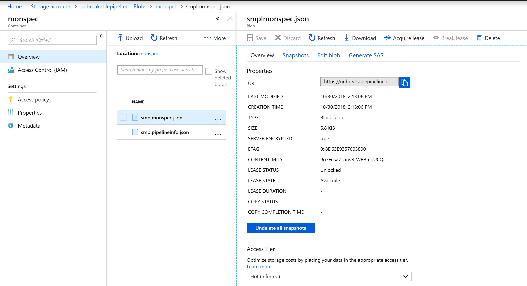
In the Azure_Devops_Values Notepad copy the URL’s of the Monspec file and the Pipeline Info File

Slide 12
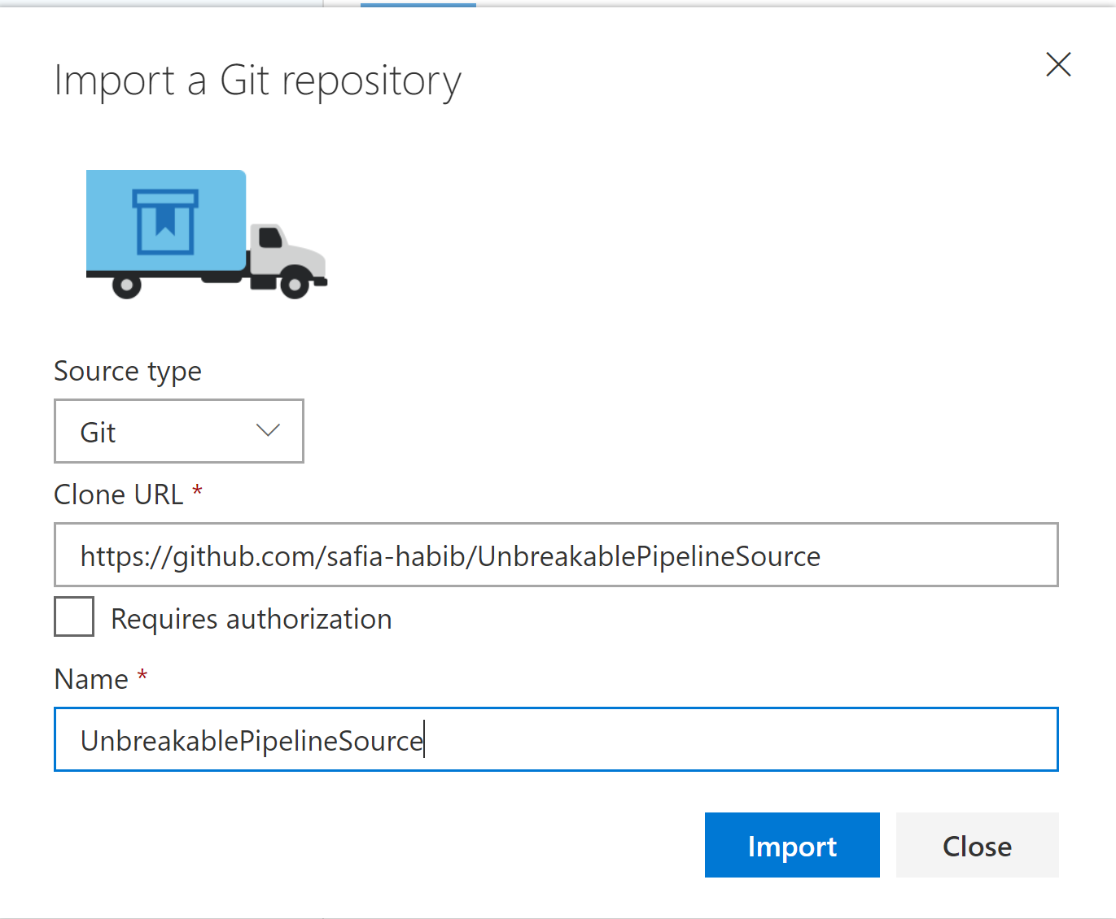
Step 2: Setup Azure Repos
Login to https://dev.azure.com
Create a New Organization
Create a New Project
Go to Repos
Import a Git Repository
URL to clone is: https://github.com/safia-habib/UnbreakablePipelineSource

Slide 13
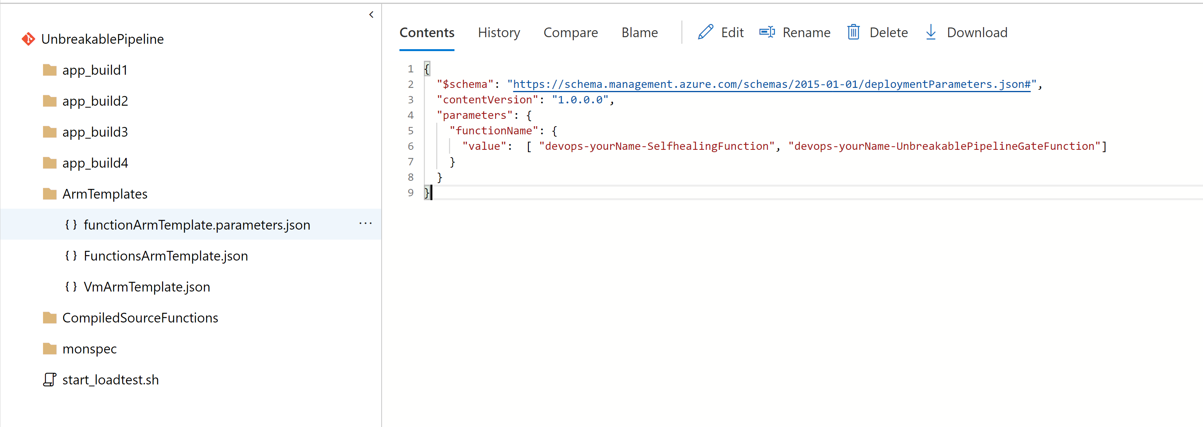
Step 2: Continuation
In the imported code navigate to ArmTemplates/functionarmTemplate.parameters.json
Replace <your Name> With your First + Last name
Commit the changes once done

Slide 14
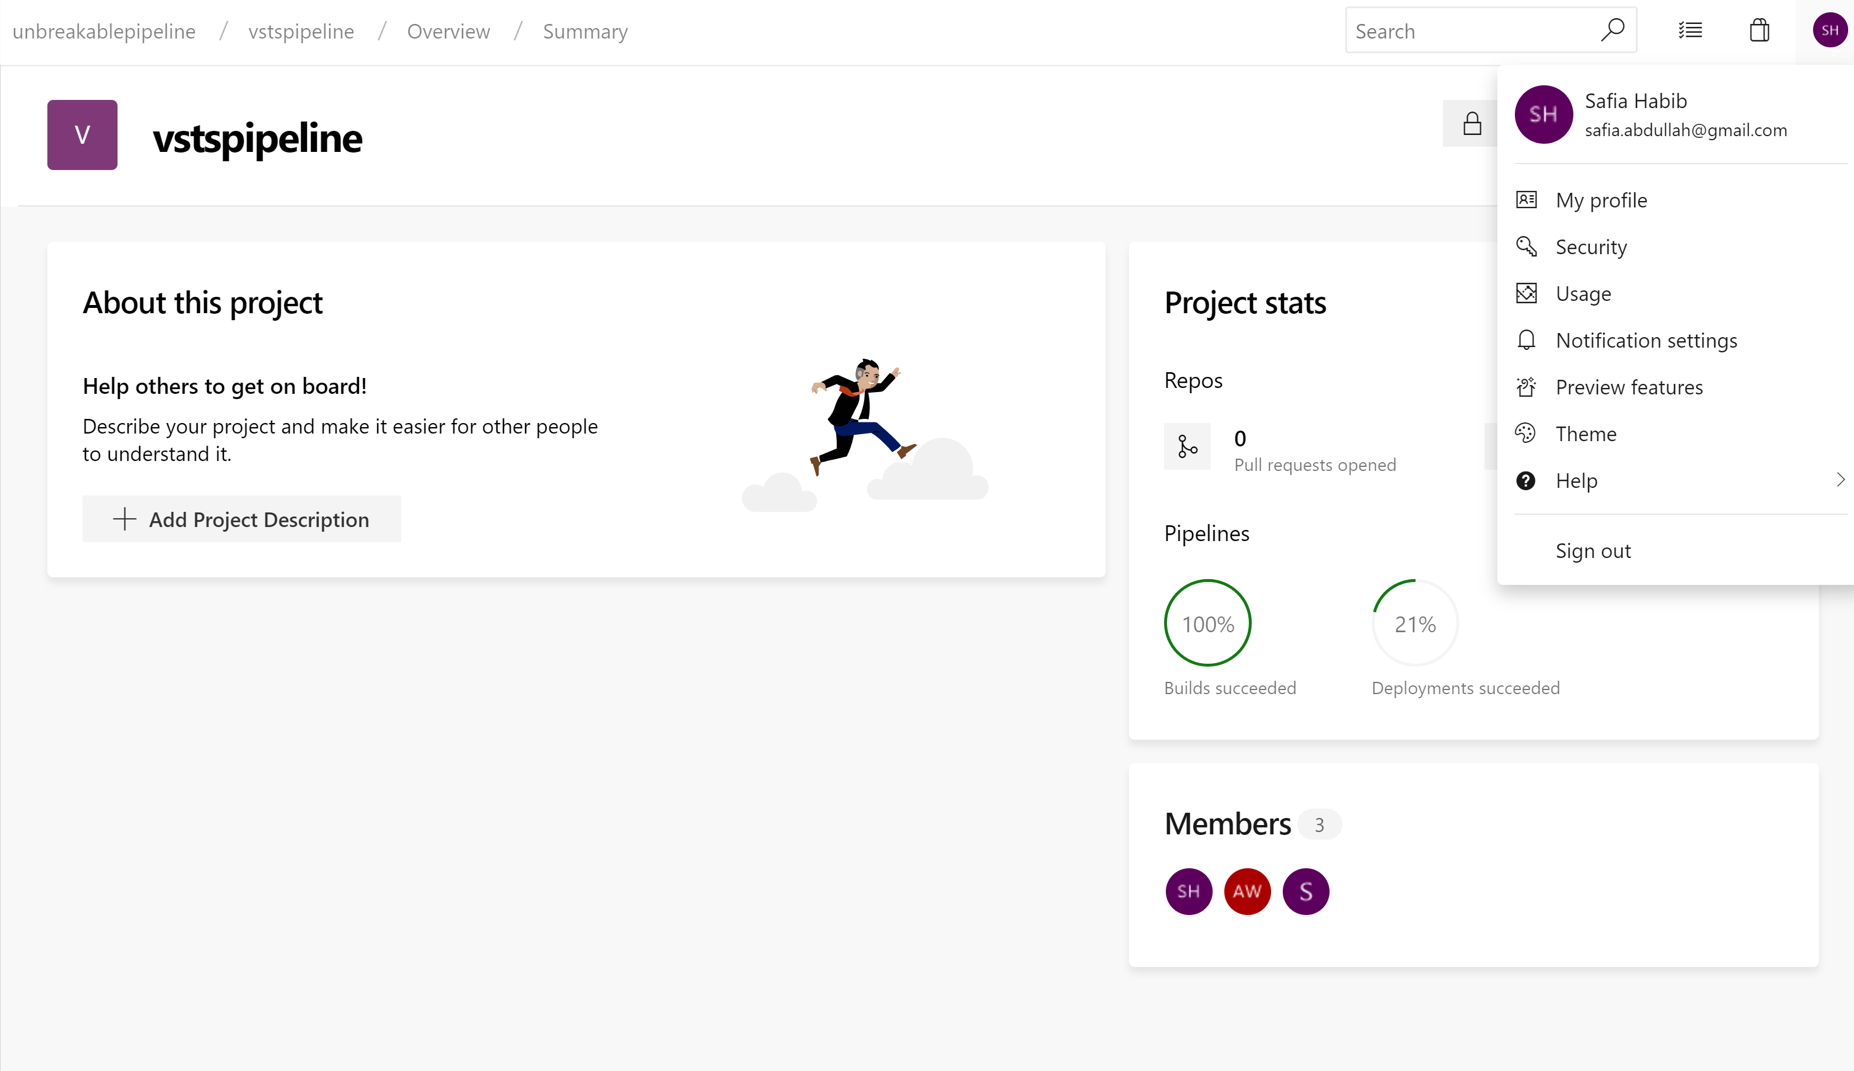
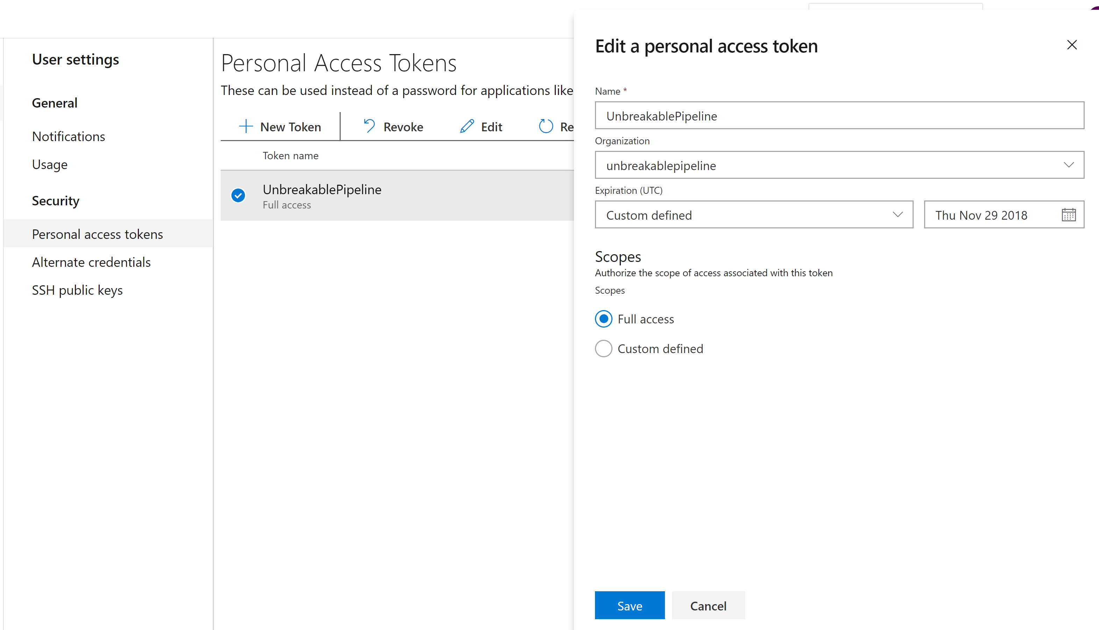
Step 3: Create a Personal Access Token
Create a PAT and Copy Value to the Notepad
Notes:
What is PAT – Personal Access Token : This is used for Authentication between the Azure Devops and Azure Portal.

Slide 15
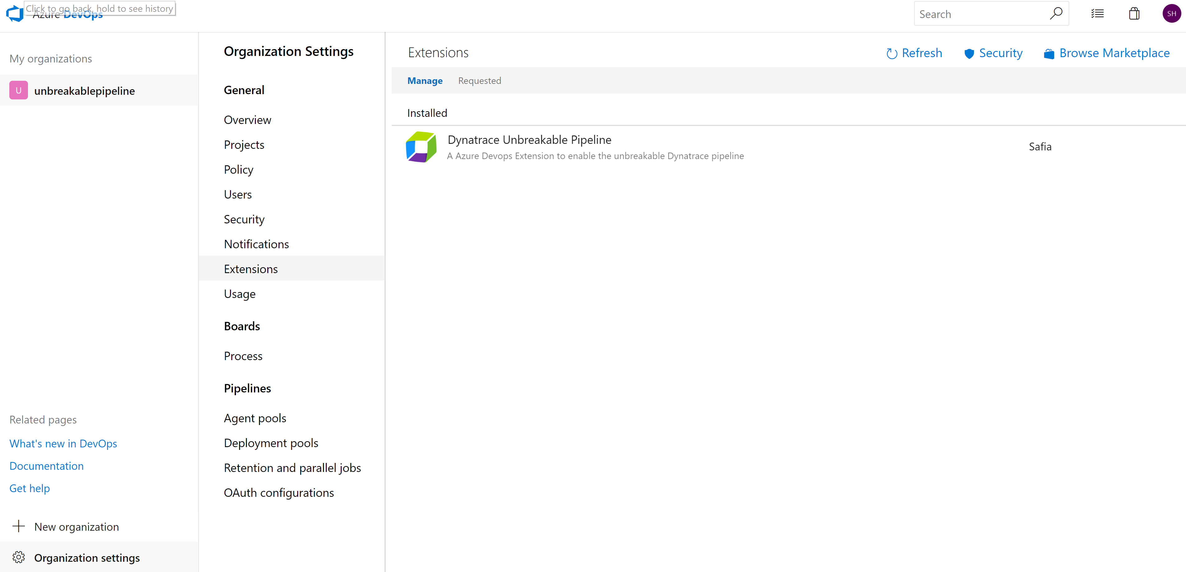
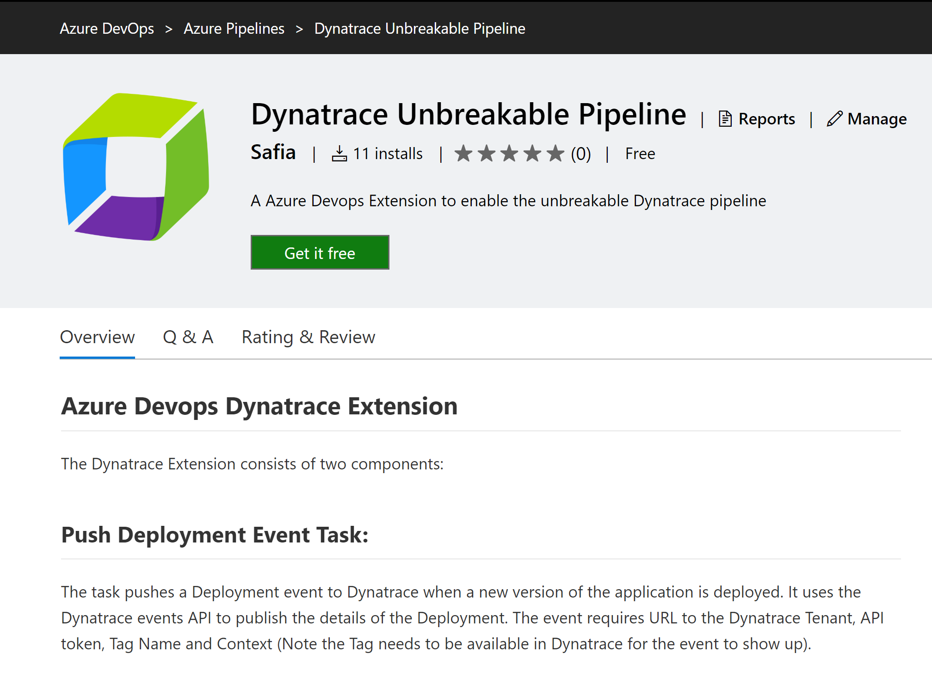
Step 3: Get the Dynatrace Marketplace Extension

Slide 16
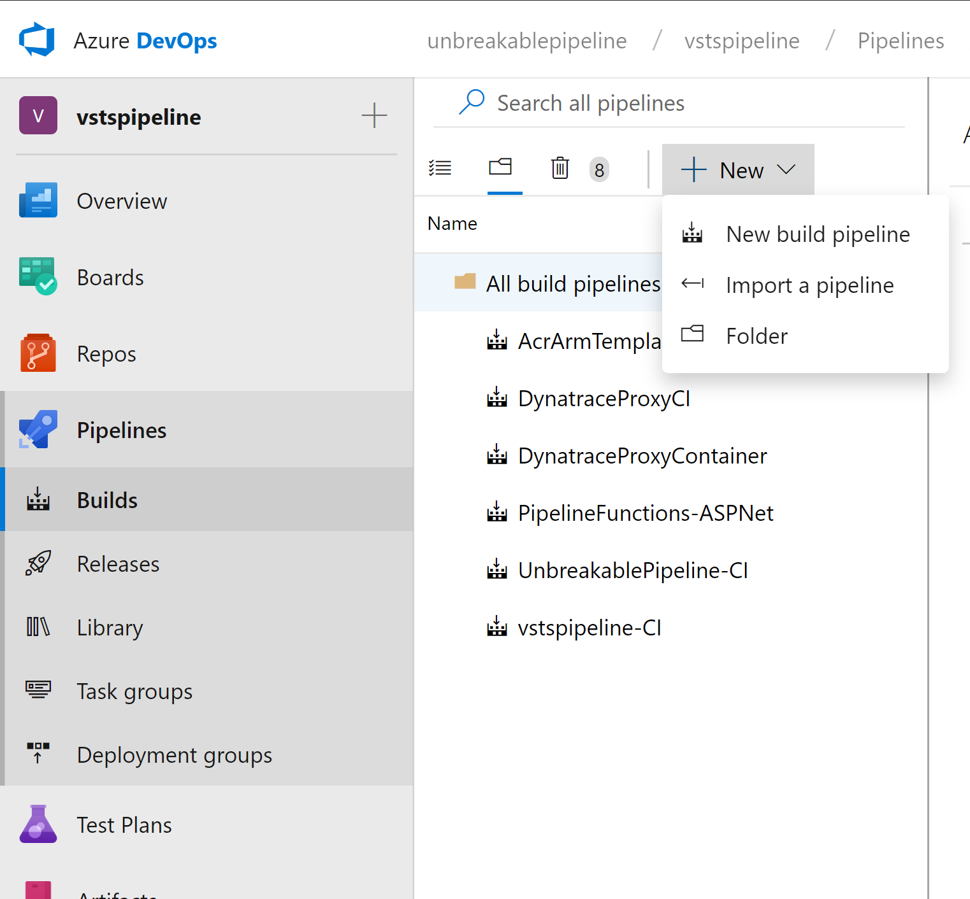
Step 4: Build Pipeline
Sometimes we have noticed that for
New Users there is no option to Import pipeline
In this case create a Dummy Pipeline With any name
To get to the below view and then import the Build pipeline
Go to Pipelines Build
Create a New Pipeline
Import the Unbreakablepipeline-CI.json
Current Limitation – Name of the Pipeline should match UnbreakablePipeline-CI

Slide 17
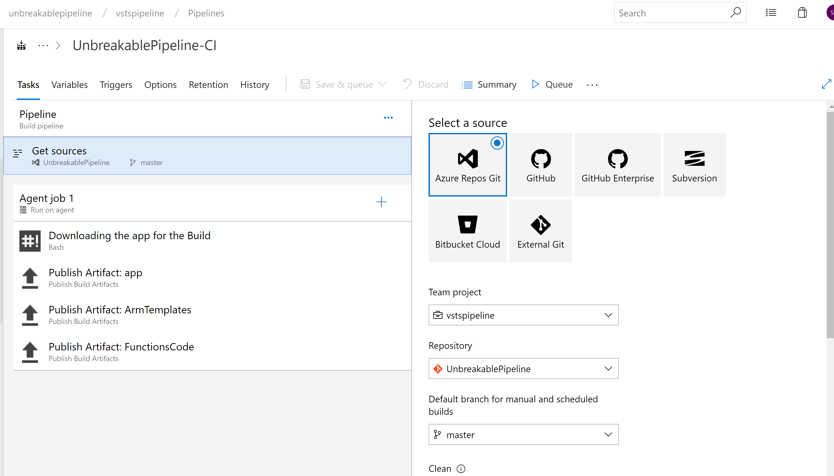
Step 4: Result
Ensure this matches the Repo Name
You created in Step 2

Slide 18
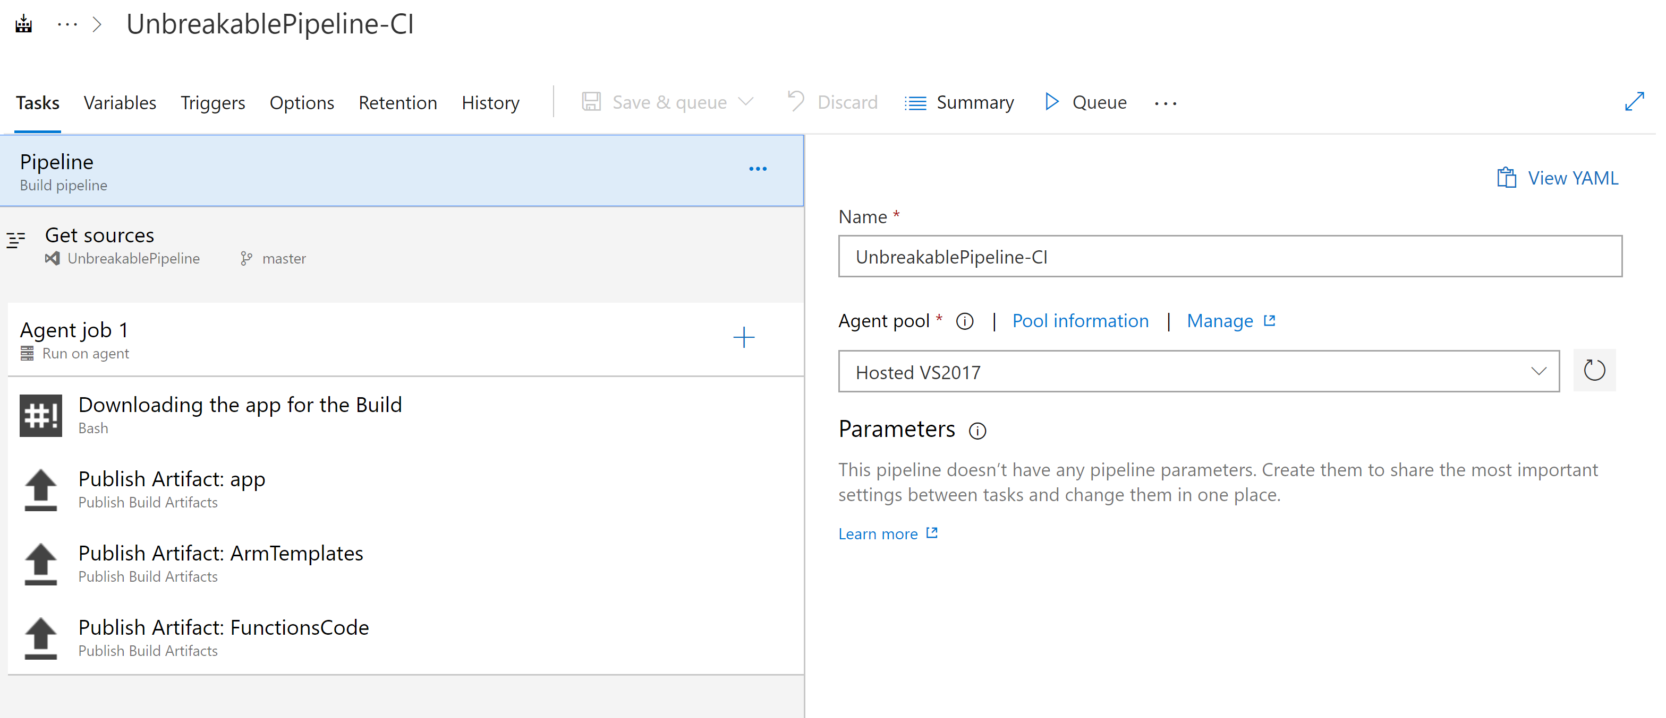
Step 4: Run the Build Pipeline
Queue a Build Pipeline

Slide 19
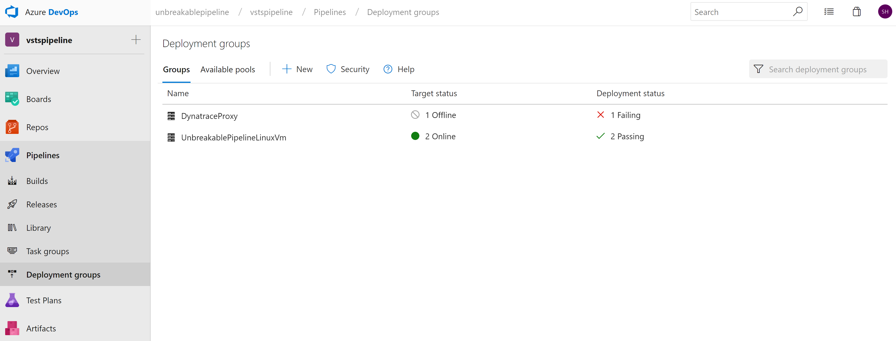
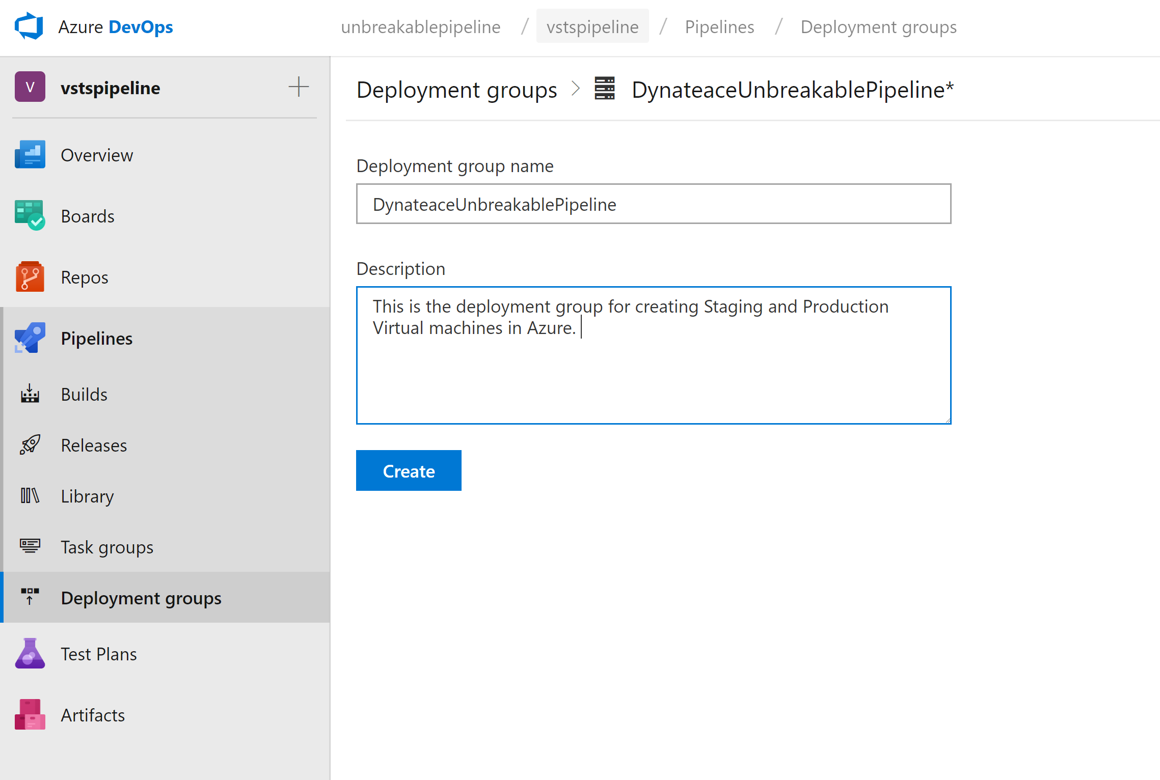
Step 5: Create Deployment Group

Slide 20
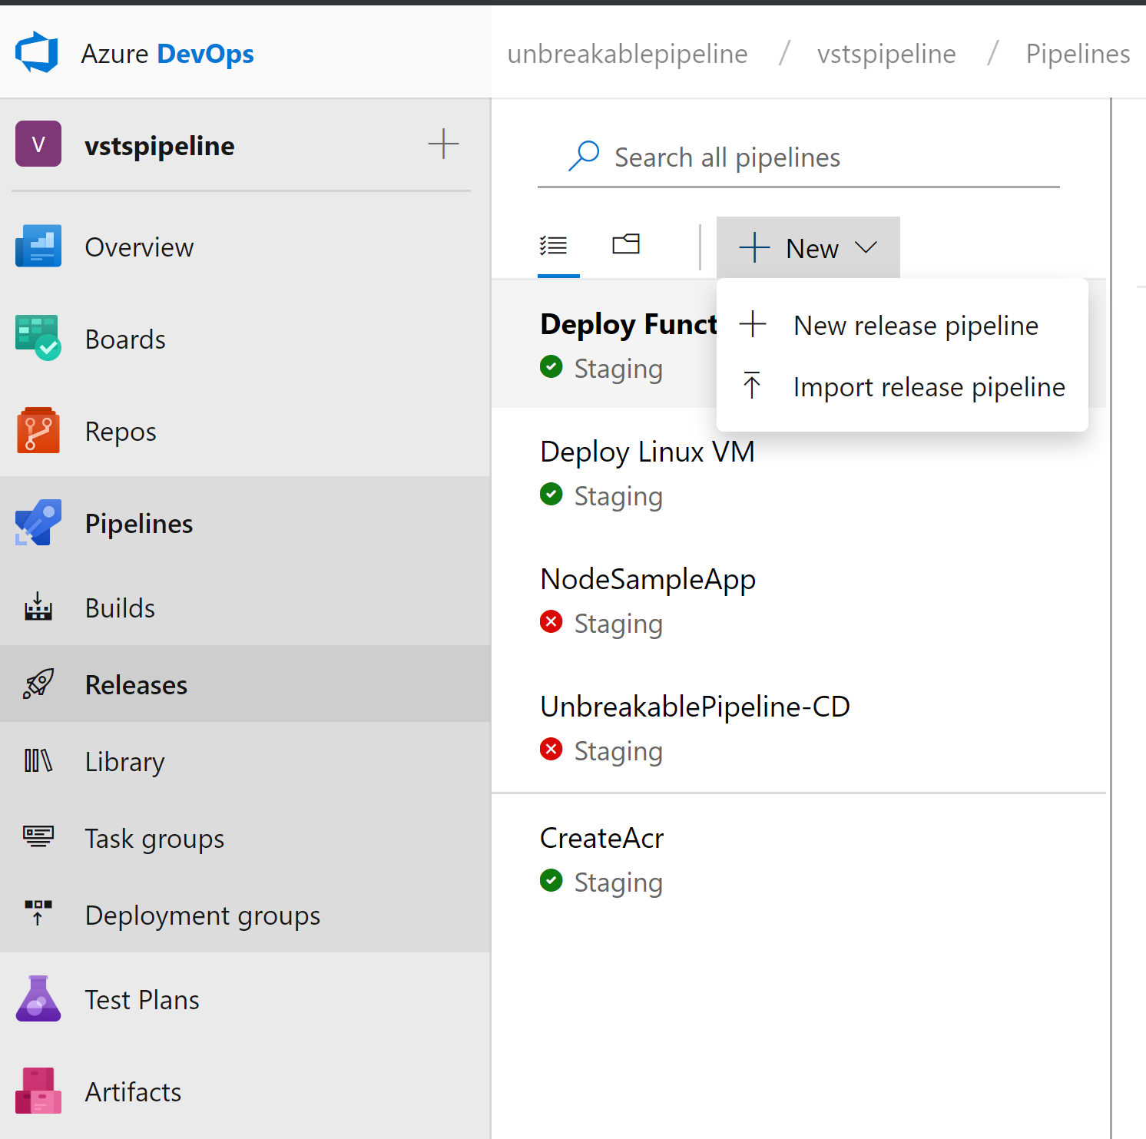
Step 5: Release Pipeline
Go to Pipelines Release
Import the CreateUtilities.json

Slide 21
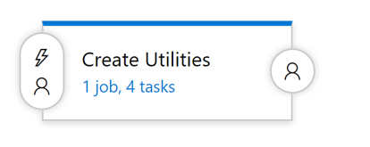
Release Stage
Create utilities
Creates the following in Azure:
Self Healing Function
Unbreakable Pipeline Gate Function
Staging Linux VM
Production Linux VM

Slide 22
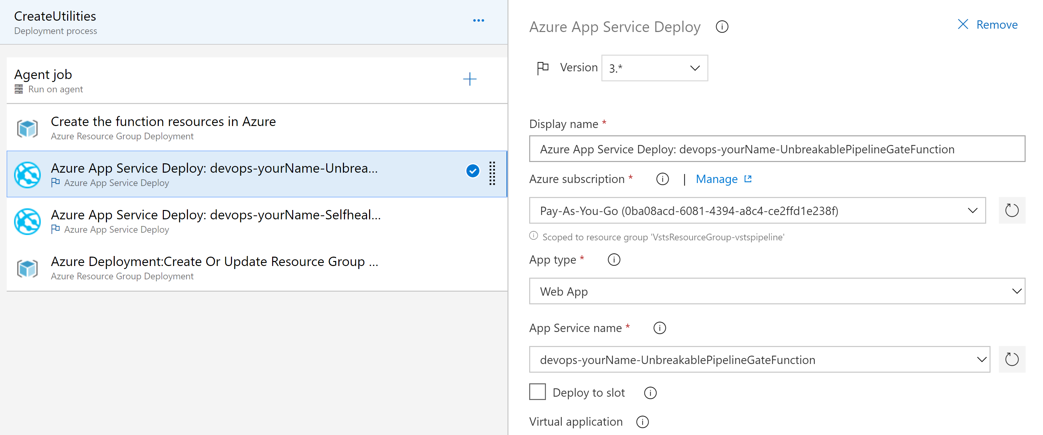
Update the App Service Name for Functions
Name should match functionarmTemplate.prameters.json

Slide 23
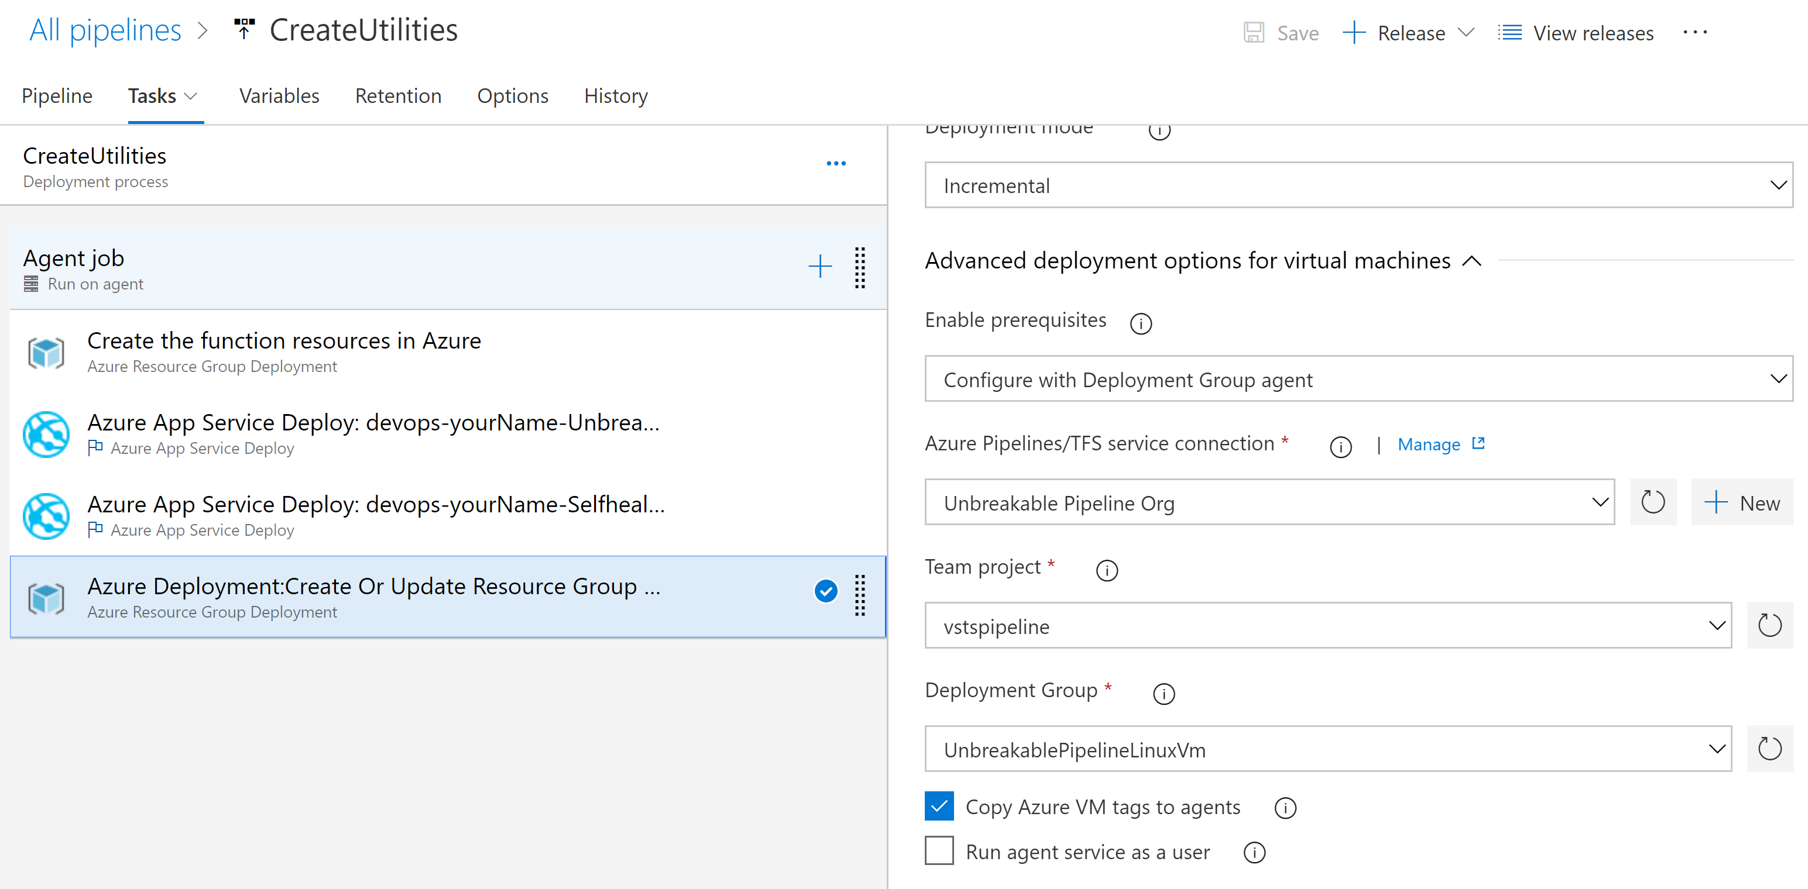
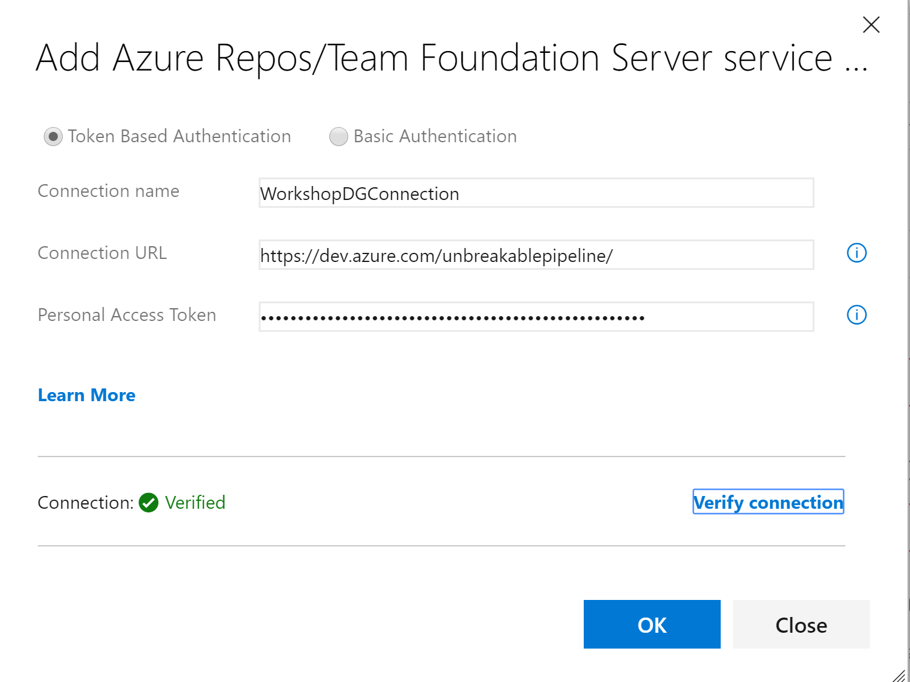
Should match Deployment Group created in earlier step

Slide 24
Open all tasks and establish connection to Azure

Slide 25
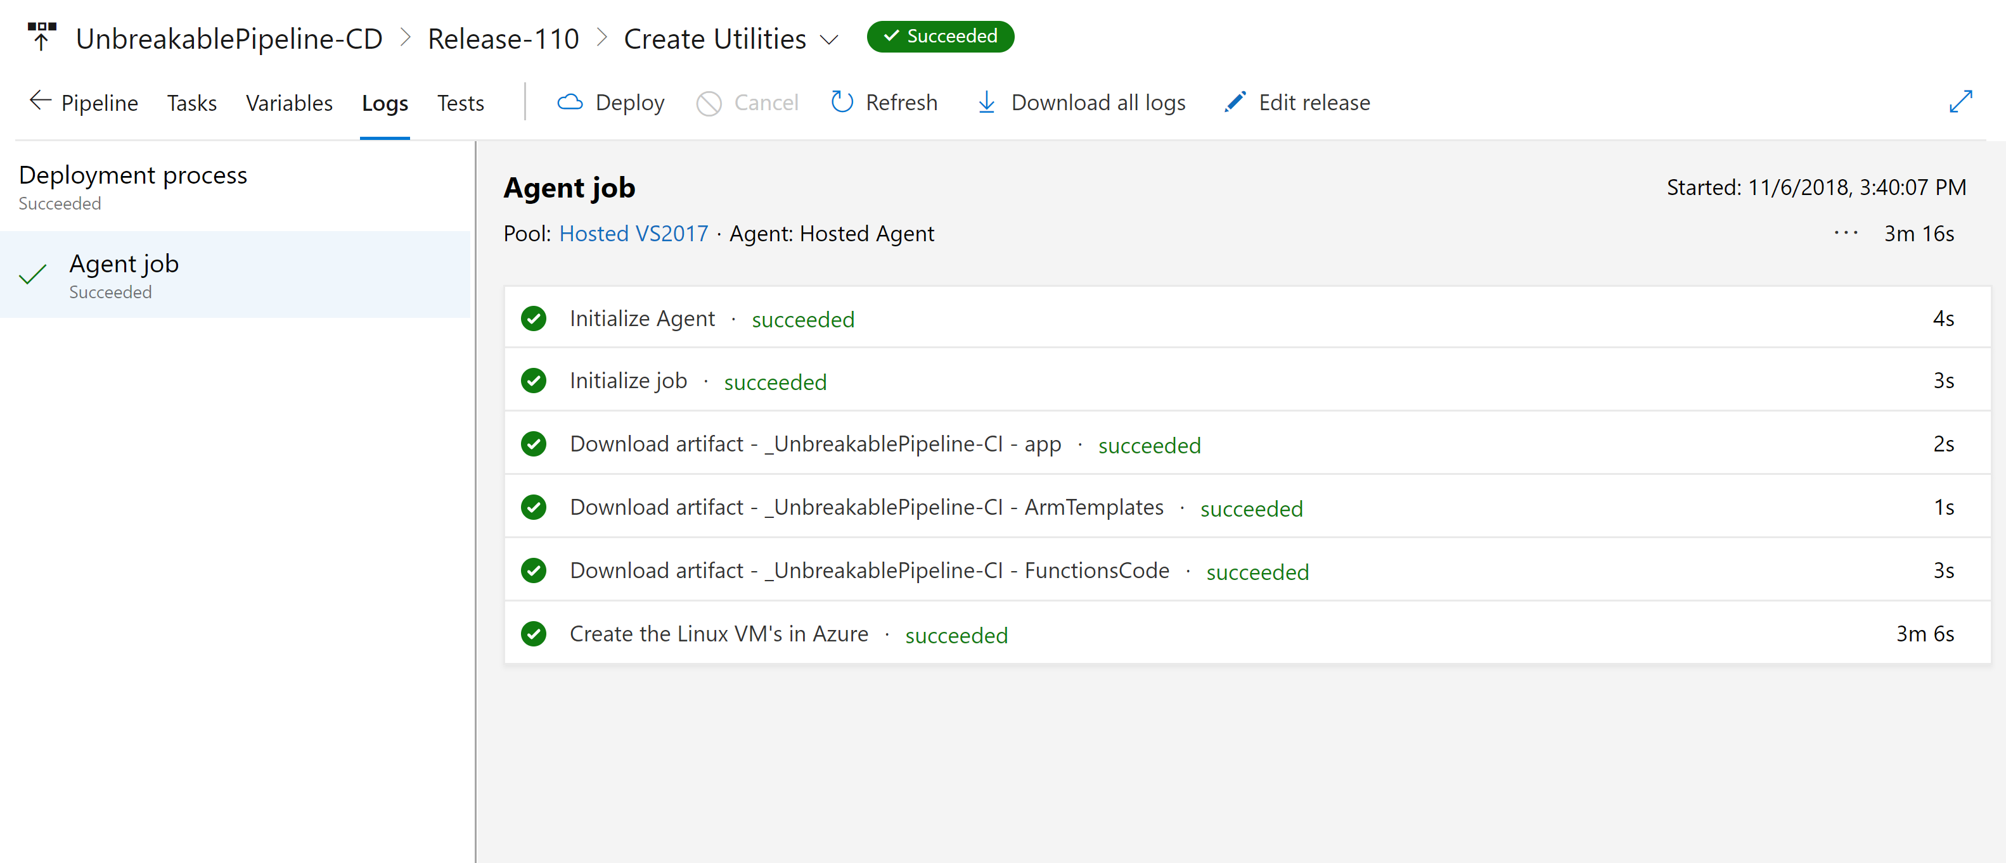
Step 6: Deploy time
First run the Create Utilities Stage

Slide 26
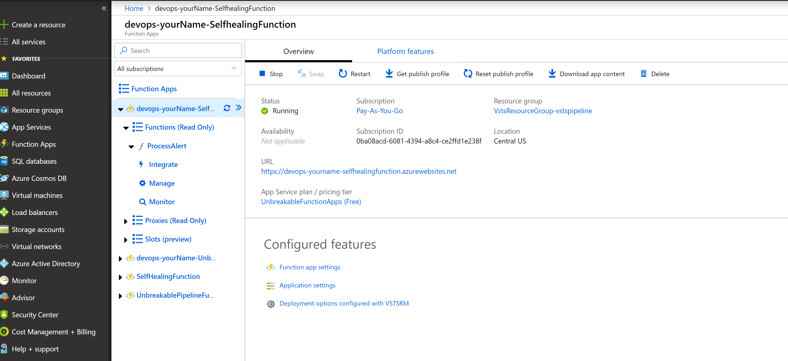
Step 6: Get Function URL’s
Go to Azure Portal and copy the Self Healing Function URL Azure_Devops_values notepad.

Slide 27
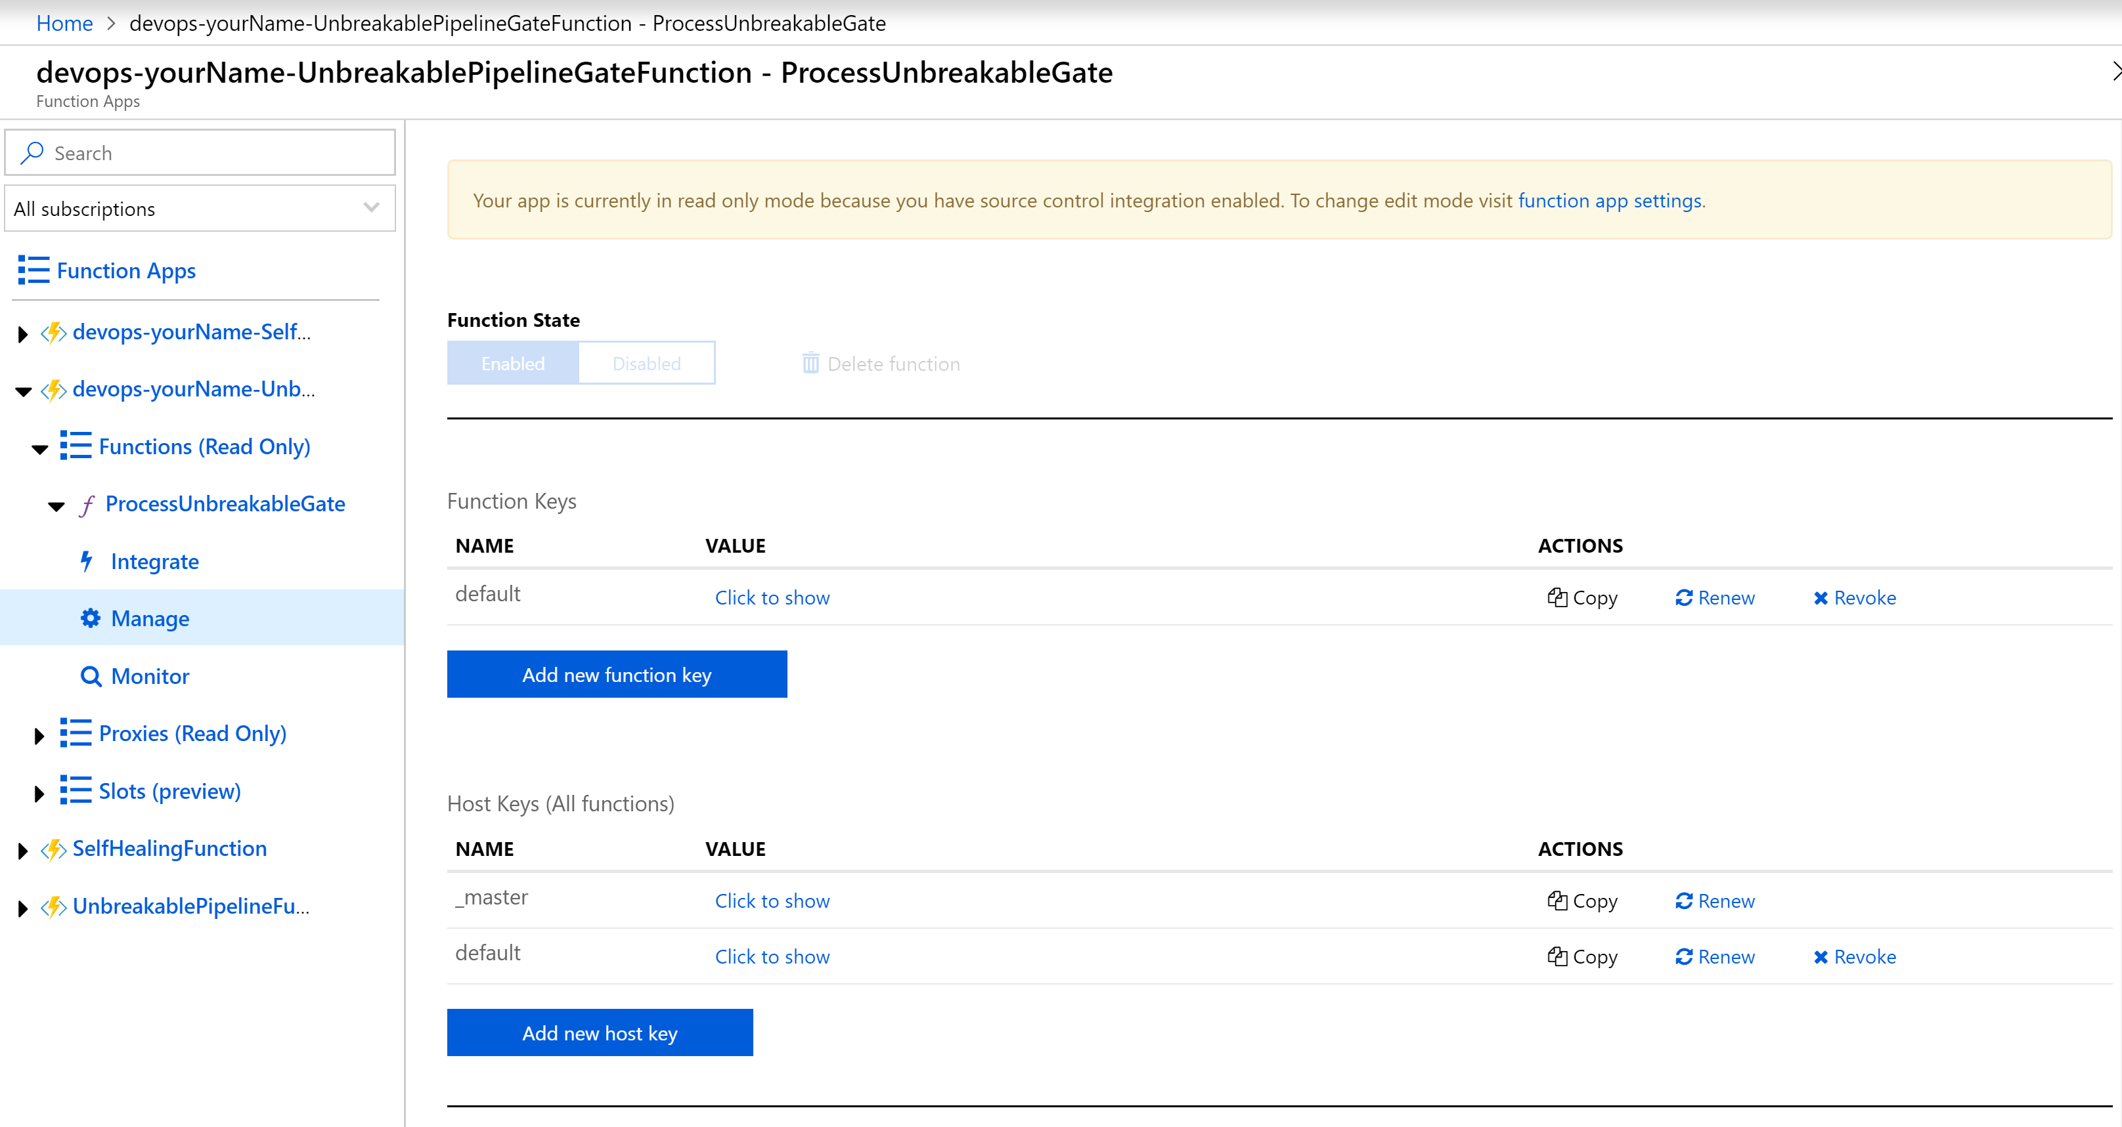
Step 6: Function URL and Key
Get the Unbreakablepipeline function URL and Key – Copy to Notepad

Slide 28
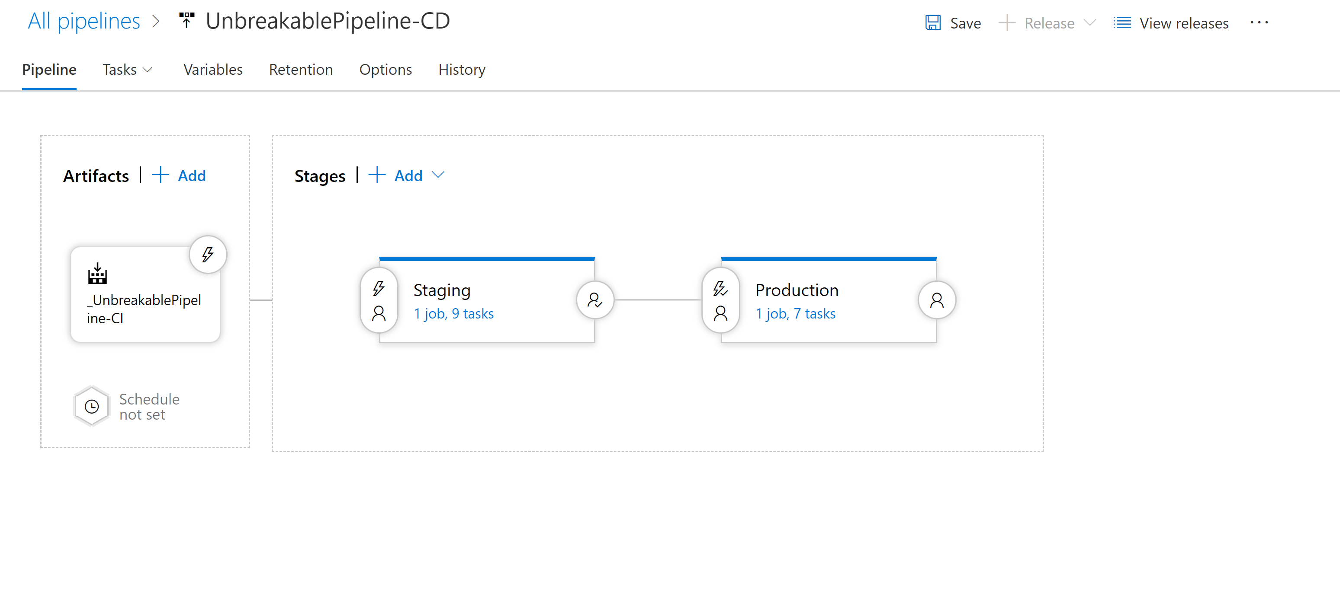
App Pipeline
Import UnbreakablePipeline-CD.json into New Release Pipeline

Slide 29
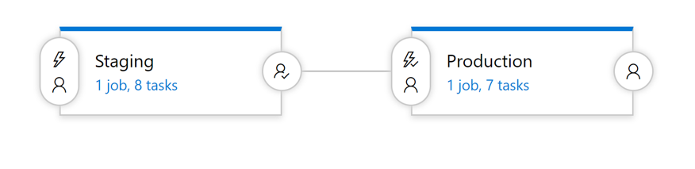
App Release Pipeline
Staging
Deploys the test app on Staging VM
Starts Loadtest against the test application
Pushes Deployment Event to Dynatrace
Production
Deploys the test app on Staging VM
Starts Loadtest against the test application
Pushes Deployment Event to Dynatrace

Slide 30
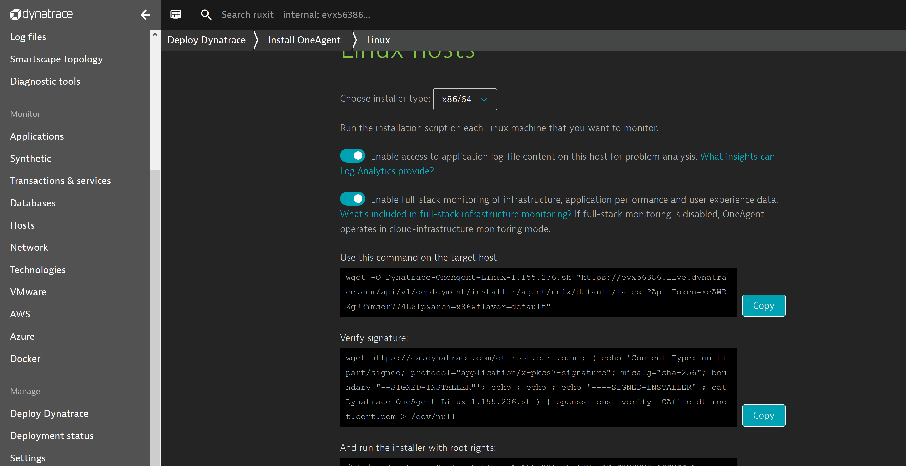
Getting values from Dynatrace
Login to the Dynatrace account you have setup for this workshop
Go to Deploy Dynatrace
Copy the first command
Pull out the values for
Dynatrace_Tenant: https://<tenant>.live.Dynatrace.com
Dynatrace_Tenant_Token: Value of Tenant token
Copy these values to the Notepad

Slide 31
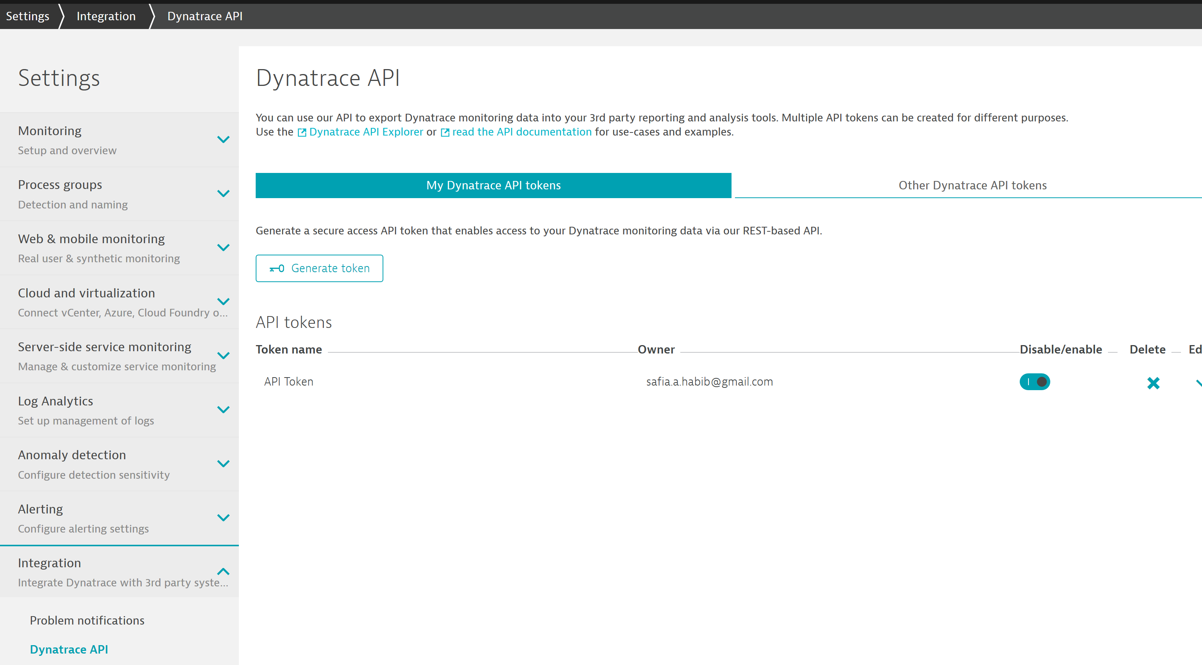
API Token Dynatrace
Go to Settings -> Integration -> Dynatrace API -> Generate token
Copy the vale of the Generated token in the notepad

Slide 32
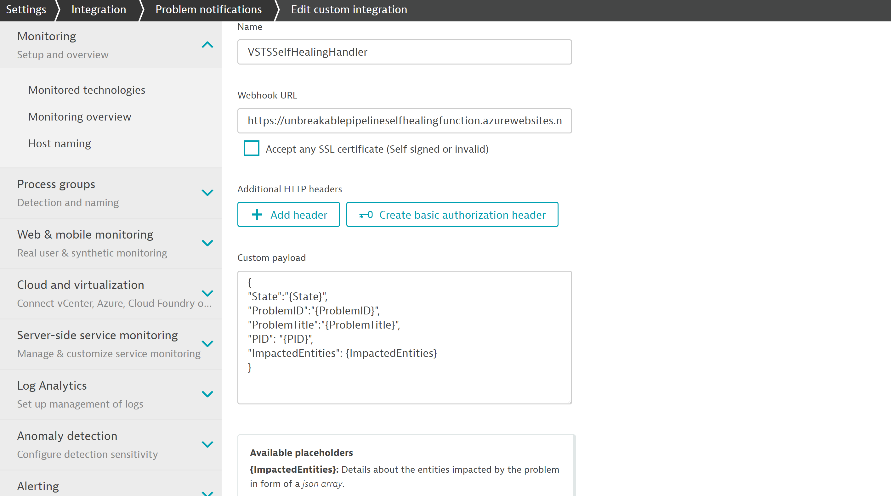
Add SelfHealing Function URL Webhook Integration
To enable auto remediation add the Self Healing Function URL to Dynatrace after creating an alerting profile
WebhookURL: SelfHealingFunction URL + /api/ProcessAlert?name=<YourName>

Slide 33
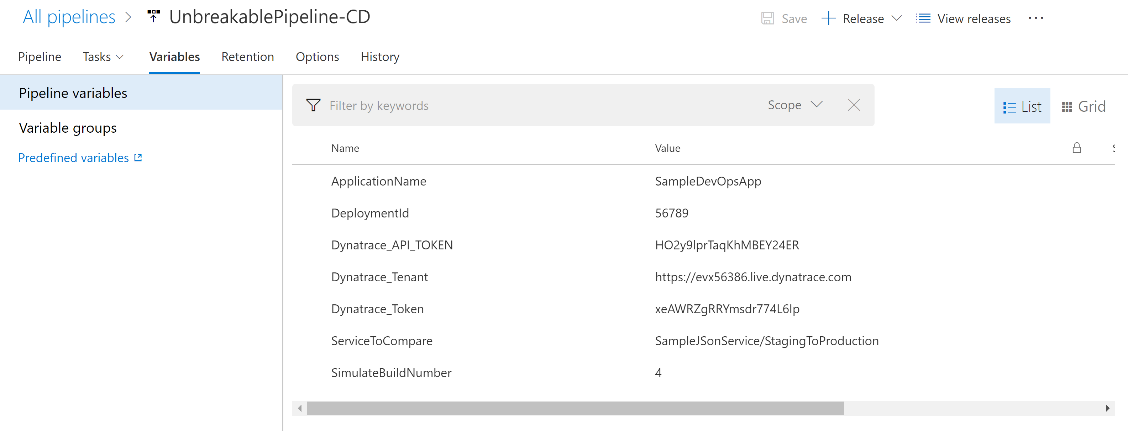
Step 6 – Release Pipeline Configuration
After Importing the release pipeline go to each stage
For Each Task in each stage you will have to select the Azure Subscription, Resource Group, Location
Add the following values for the Variables in the Variables Section

Slide 34
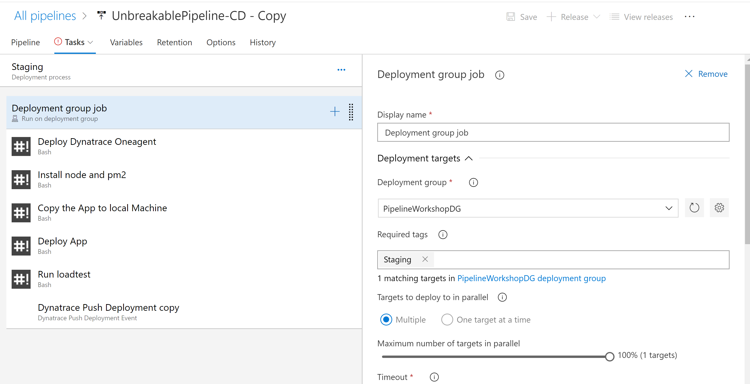
Add Tags for each Deployment group Staging OR Production

Slide 35
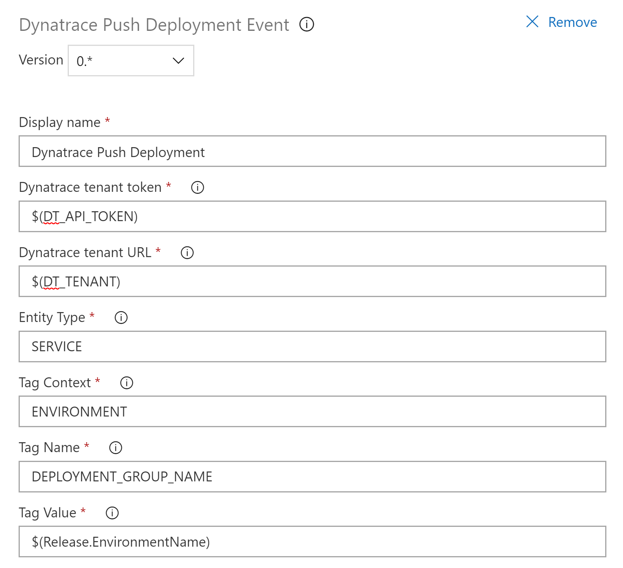
Push Deployment Event Task
Update the values in Push Deployment Event Task for Staging and Production

Slide 36
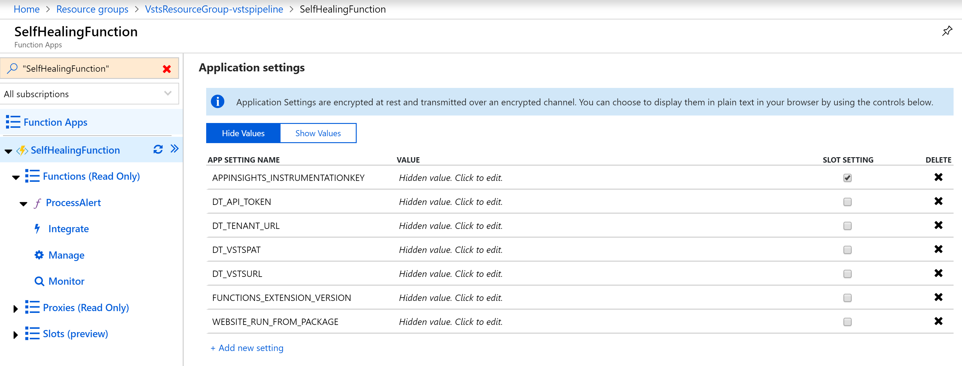
Configure Self Healing Function on Azure
Create Environment Variables
Copy from Azure_Devops_Values.txt

Slide 37
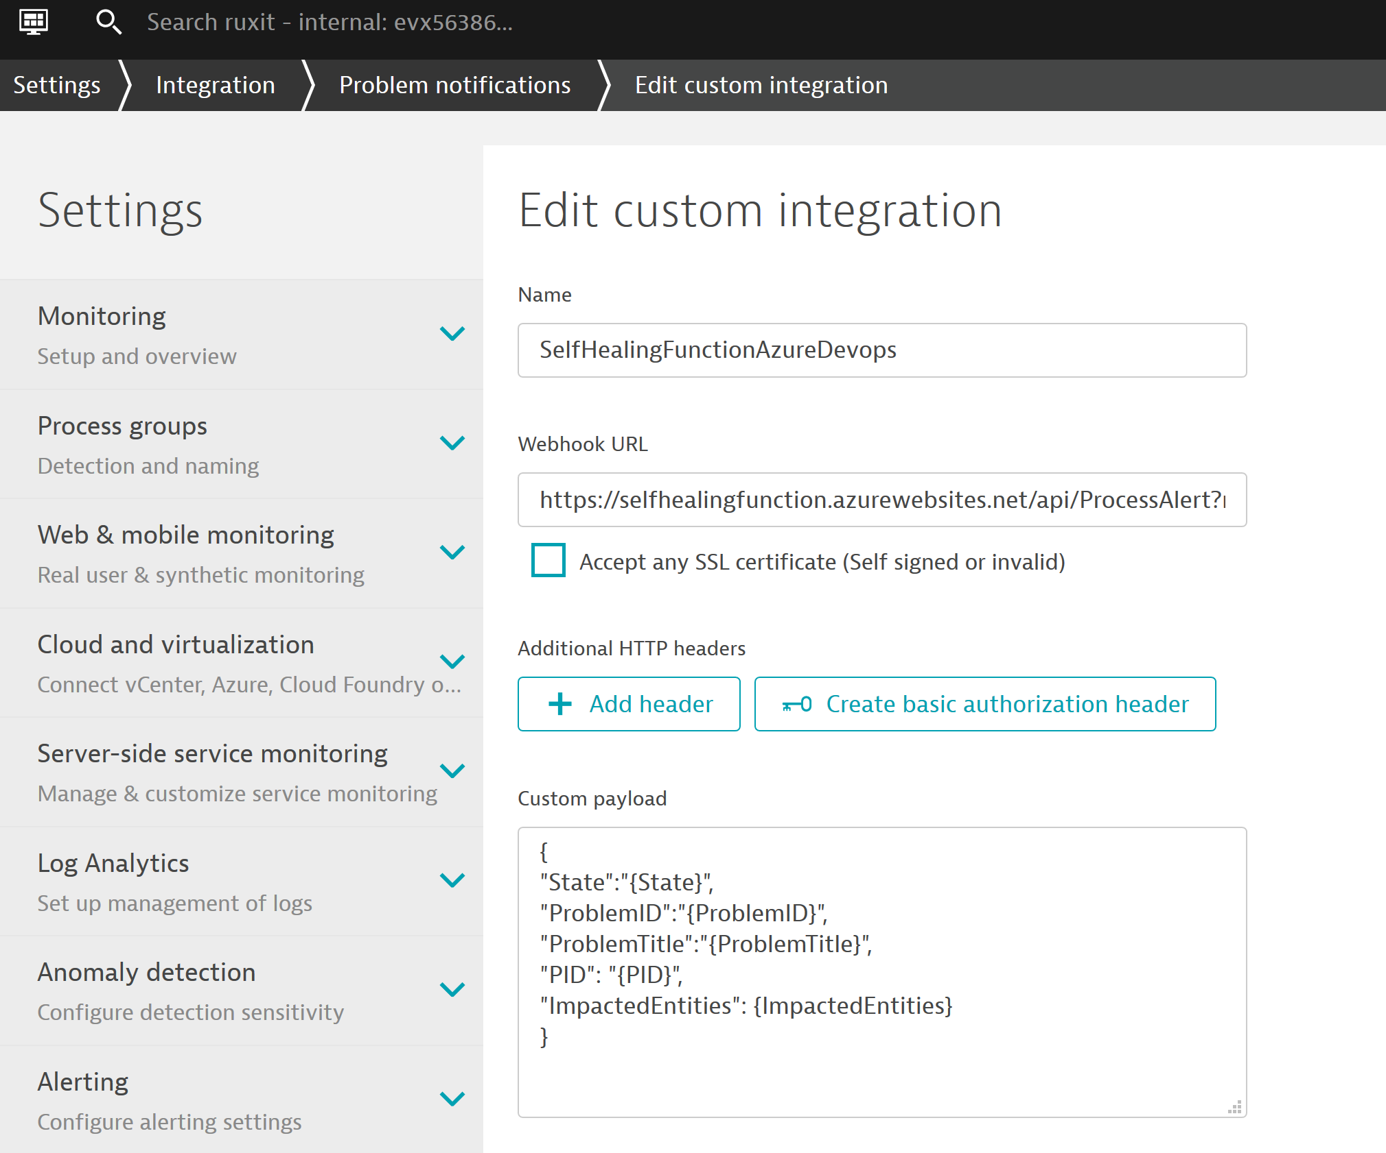
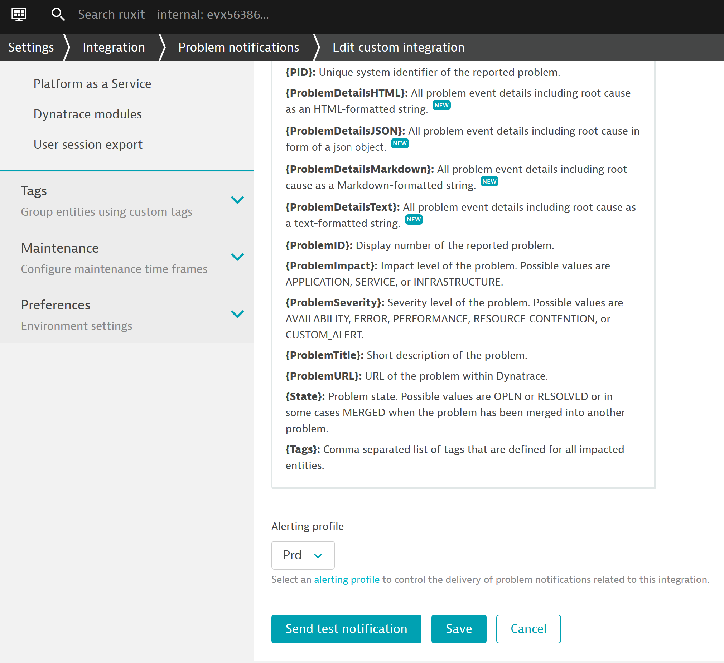
Configure Self Healing on Dynatrace
SelfHealingFunctionURL/api/ProcessAlert?name=<yourname>
Edit the Payload
Test n Save

Slide 38
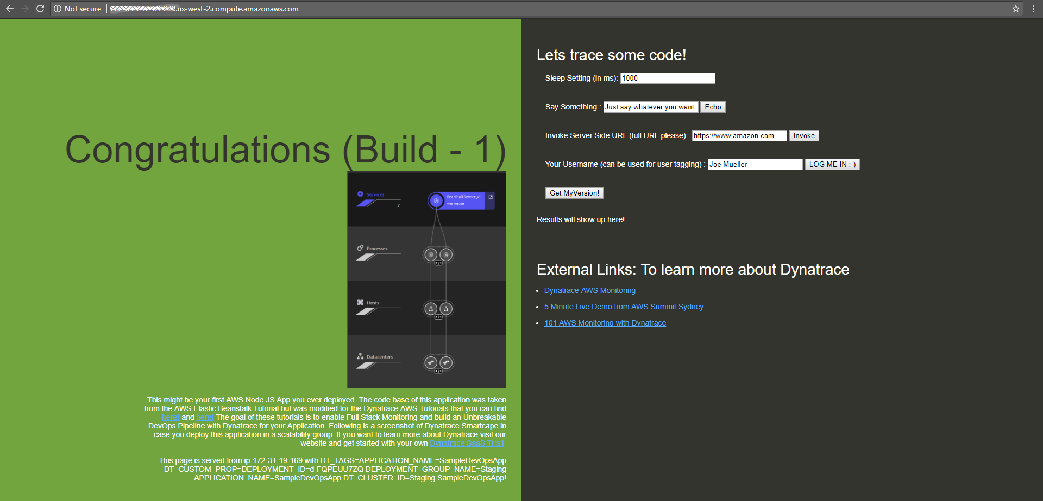
Lets Explore our Application in Staging: Not a Web UI Masterpiece – but it works ☺
In your Browser: http://YOURPUBLICDNSFORSTAGINGEC2INSTANCE.amazonaws.com

Slide 39

Explore our Services in Dynatrace: Everything Monitored, Everything Tagged
#1: Default Service Name from package.json
#2 Our DeploymentGroup tag
#3 Our Deployment Event
Crated by pushDynatraceDeploymentEvent

Slide 40


Update Release gate

Slide 41
Values for Release Gate
Note: Unbreakable Gate Function URL : URL + /ProcessUnbreakableGate
Dynatrace Proxy URL: http://40.117.92.217:5000/api/DTCLIProxy/MonspecPullRequest
Service to Compare value: SampleJSonService/StagingToProduction
Authentication Token : PAT Token

Slide 42



Slide 43
Behind the Scenes: Approval Stage Shift-Left: Automate Metric Comparison to Validate Build

Slide 44


Inspired by Continuous Performance Teams @ Dynatrace, Intuit, REI, PayPal …
“Performance Signature” for Build Nov 16
“Performance Signature” for Build Nov 17
“Performance Signature” for every Build
“Multiple Metrics” compared to prev Timeframe
Simple Regression Detection
per Metric

Slide 45


Monitoring as Code: Compare Metrics of Services of Different Environments/Builds
Entity: SampleJSonService
Different Metrics
Environment: Staging
Tag: DeploymentGroup:Staging
Environment: Production
Tag: DeploymentGroup:Production
Metrics: ResponseTime (Avg)
Metrics: ResponseTime(Max) < 10s
Metrics: FailureRate(Avg)
Metrics: ResponseCount
Factor: 90% Less vs Production
Different Comparisons
Compare: StagingToProduction
Source: Staging; Compare: Prod
Factor: Staging = 10% Slower
Compare: StagingToProdYesterday
Source: Staging; Compare: Prod
Factor: 10%, Timeshift: 86400s
Compare: StagingToStagingLastHour
Source: Staging; Compare: Staging
Factor: 0; Timeshift: 3600s
Compare: StageToStageYesterday
Source: Staging; Compare: Staging
Factor: 0; Timeshift: 86400s
Pipeline Run: Validate Build with StagingToProduction
Source (Staging): 1.64ms
Environment: Staging
Environment: Production
Compare (Production): 1.41ms
Threshold (+10%): 1.56ms
Status: VIOLATION

Slide 46

Automate the Comparison: Trigger it for each Build and keep track of status!
Comparisons
Entity
Metrics
Environment
Good Build
Good Build
Good Build
Bad Build
Bad Build
Bad Build
Good Build
Bad Build

